Slide 1
Artificial Intelligence, Machine Learning and Microsoft Cognitive Services

Slide 2
Does your bot need AI?
Probably not
Azure Search
Existing APIs
Button driven
Like any other feature, use them to provide better experience
Natural language processing (NLP)
Mood detection

Slide 3
“Artificial Intelligence is just whatever a computer can’t do yet…”
Chris Bishop, Microsoft Research
Notes:
Chris is probably somewhere in the building today. In fact, is he here?
The continuing moving of the goal post.

Slide 4
“Artificial Intelligence is computers doing things that we would normally think of as intelligent in humans.”
Rick Barazza, Microsoft DX
Notes:
Our working definition.
It’s not just doing things that humans do. That’s not very hard. Humans do all sorts of dumb things that much simpler animals do. So we’re setting the bar higher than that. But not crazy high. We’re saying, AI is about carving out more and more pieces of intelligent behavior. And so by that definition AI is here today, and has been for a while now.
Before we talk about how Artificial Intelligence works, let’s talk briefly about Natural Intelligence.

Slide 5
Algorithms
Diseased?
Notes:
Start with a specific question: “Is this retinal scan of a diseased eye?”
Build the puzzle by necessity. Don’t mention something new (features) until you need it.
Built the puzzle
Talk about how you spend your time (calling out data wrangling as something that developers already do – “metadata scientist”)
Talk about math, how much you need, where you need it
Also a chance to talk about hidden bias in data, e.g. skew towards men in software. So an ML “should I hire this person” would weight men heavily. The data is not bad, it’s just reflecting a situation that is itself the result of bias. The way to subtract it is to extract it explicitly.
But this is also an opportunity! We can’t subtract bias from people’s brains, but we can subtract it from models. So that “hiring engine” may in the end be a force for social justice.

Slide 6
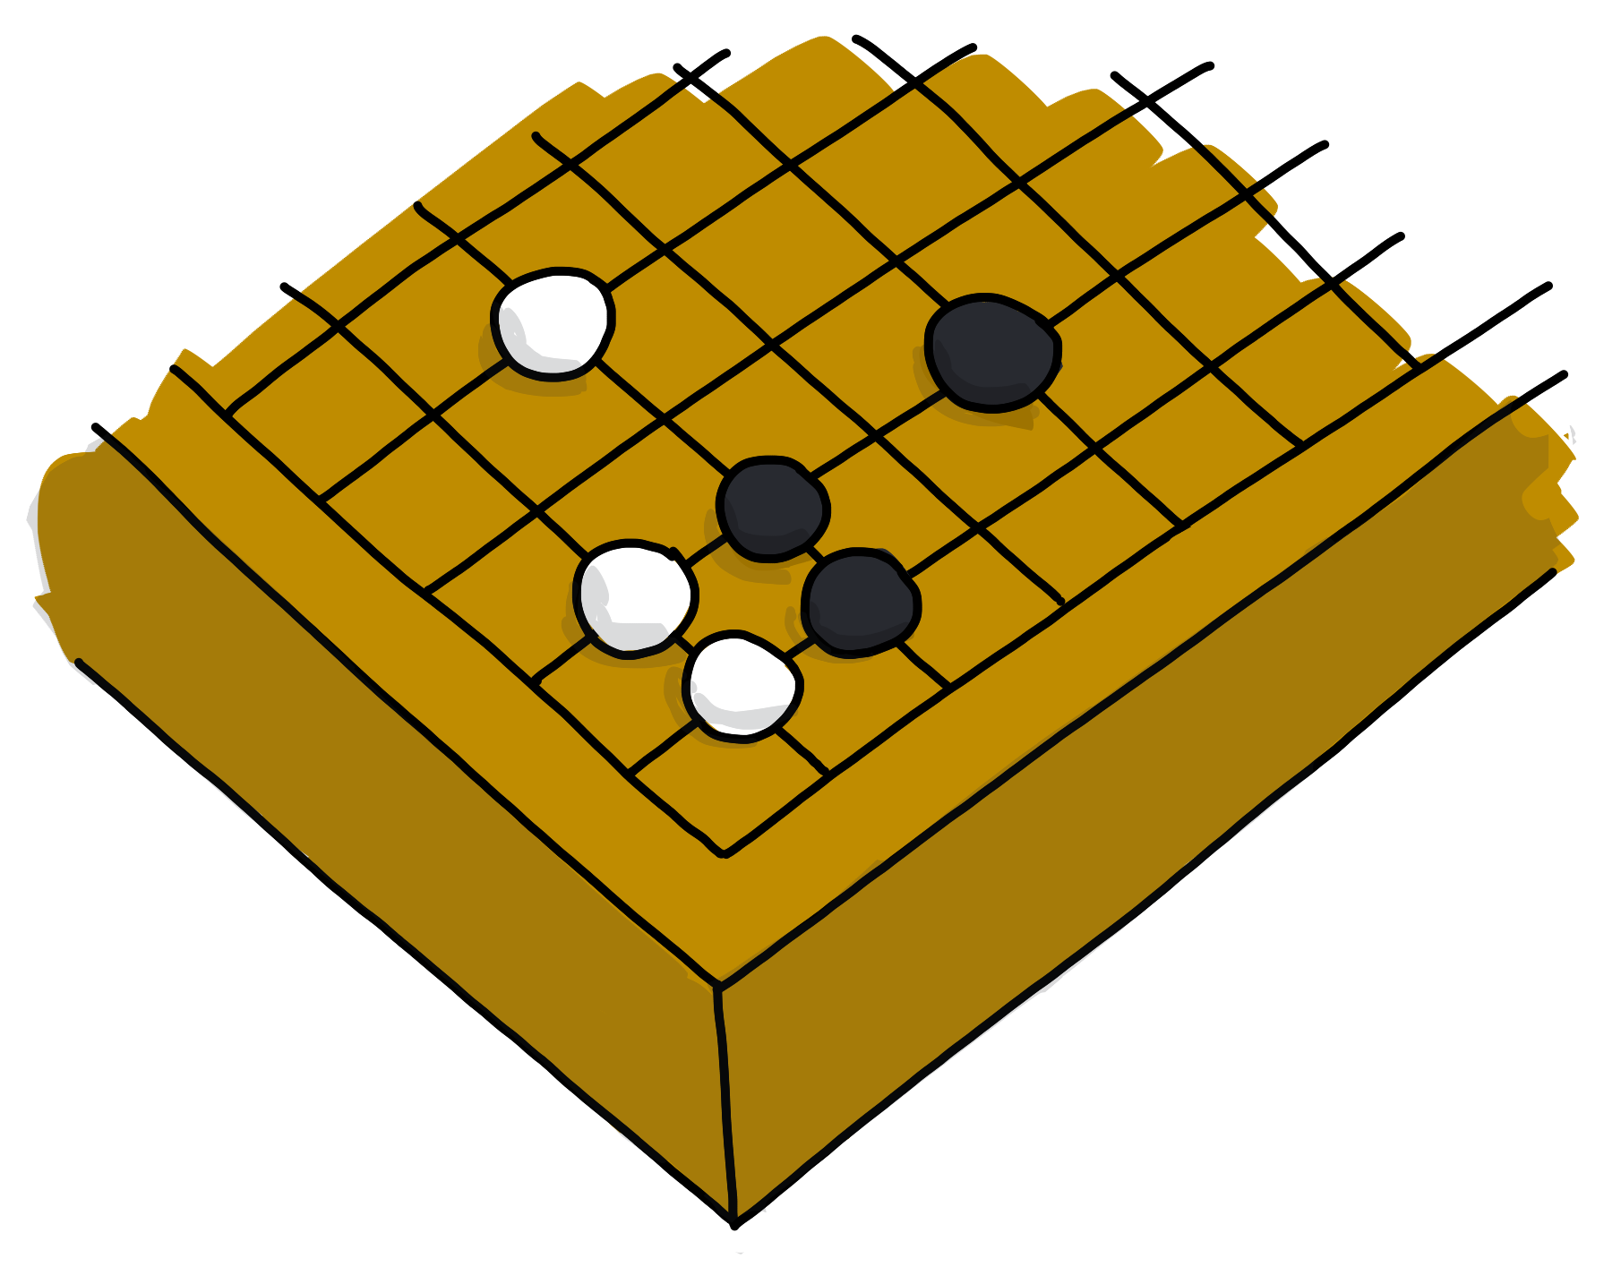
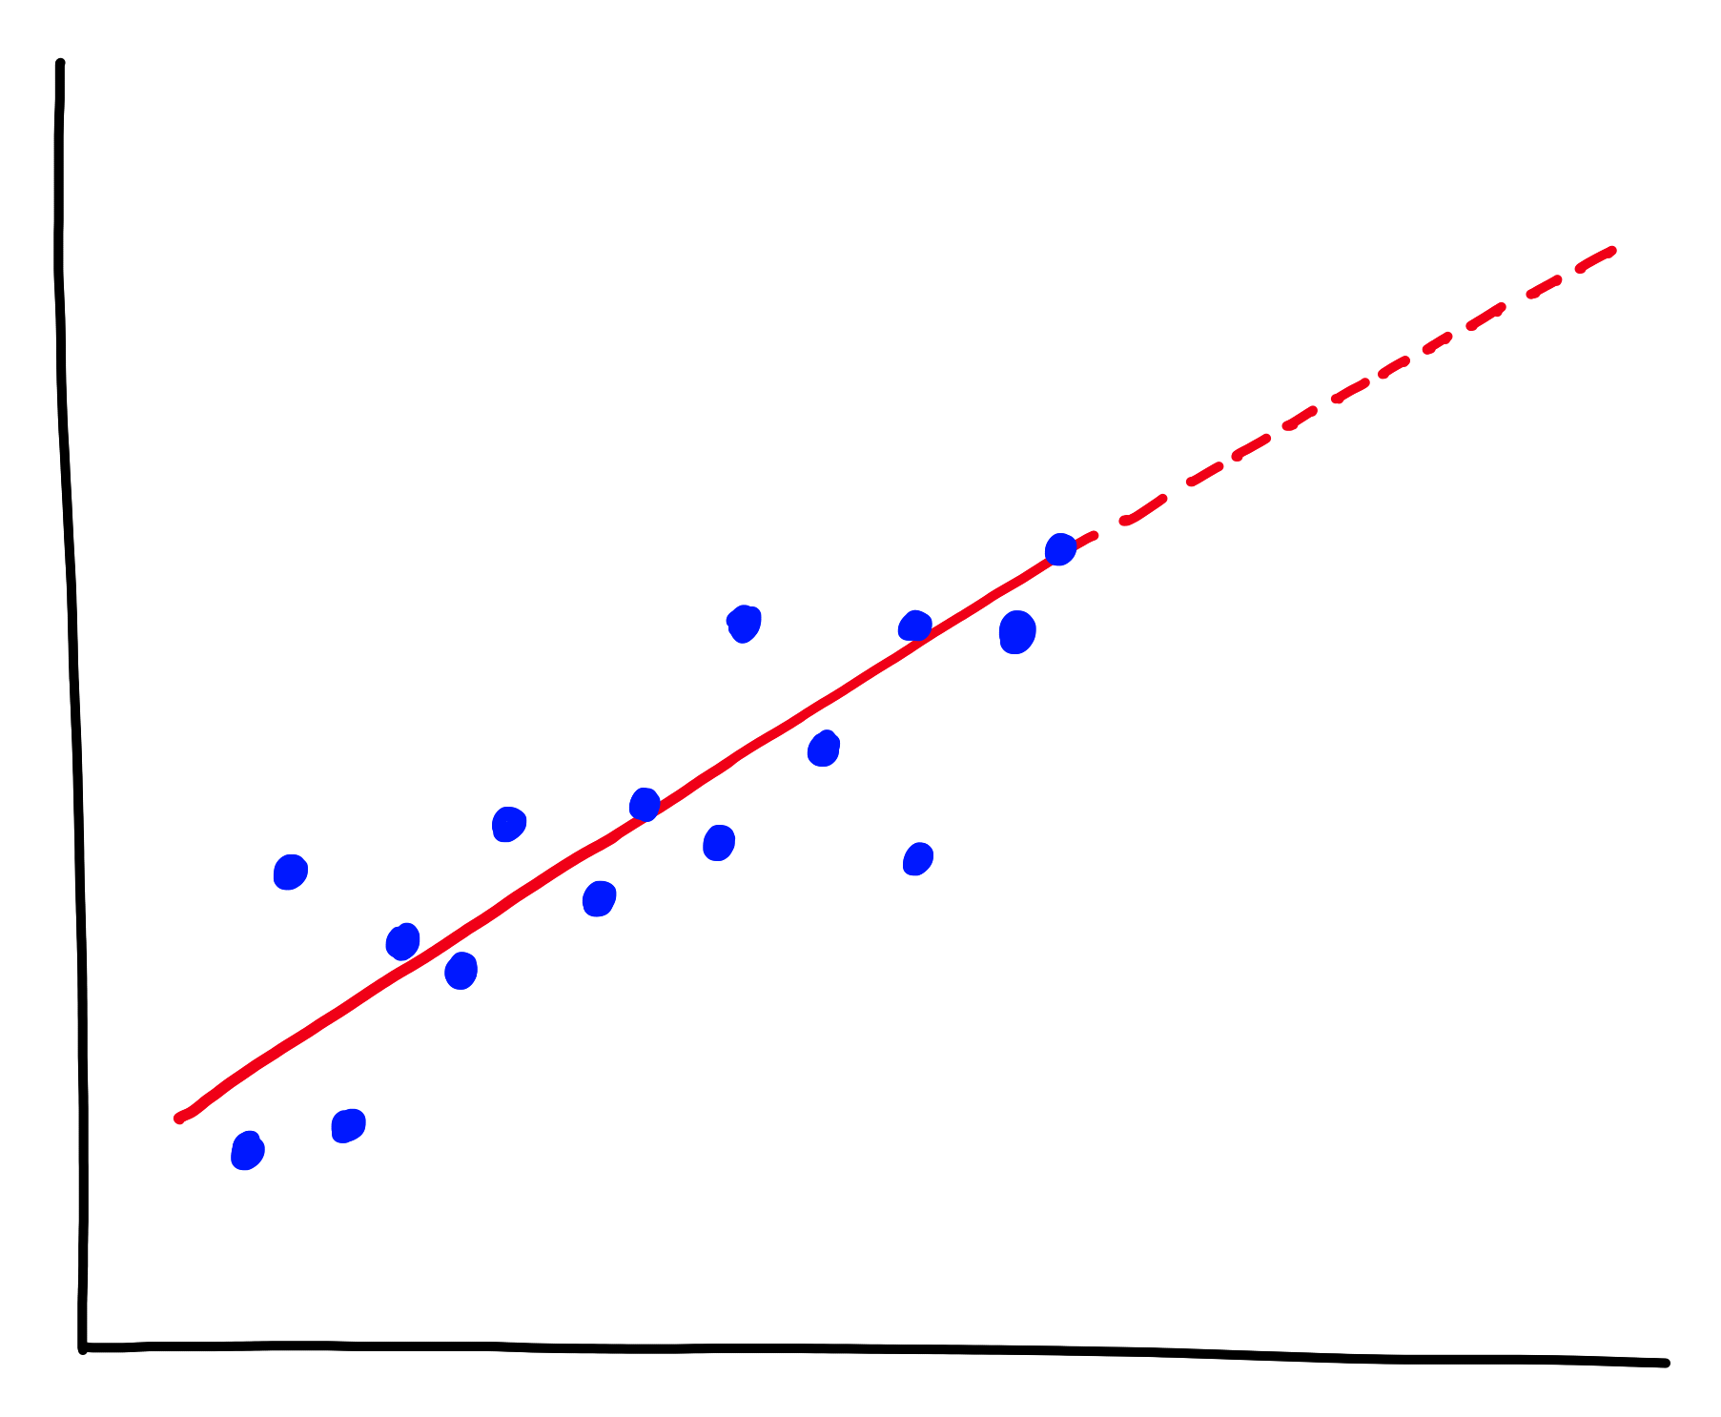
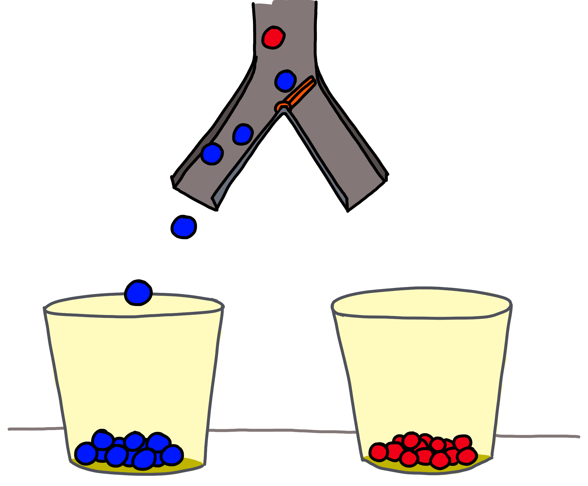
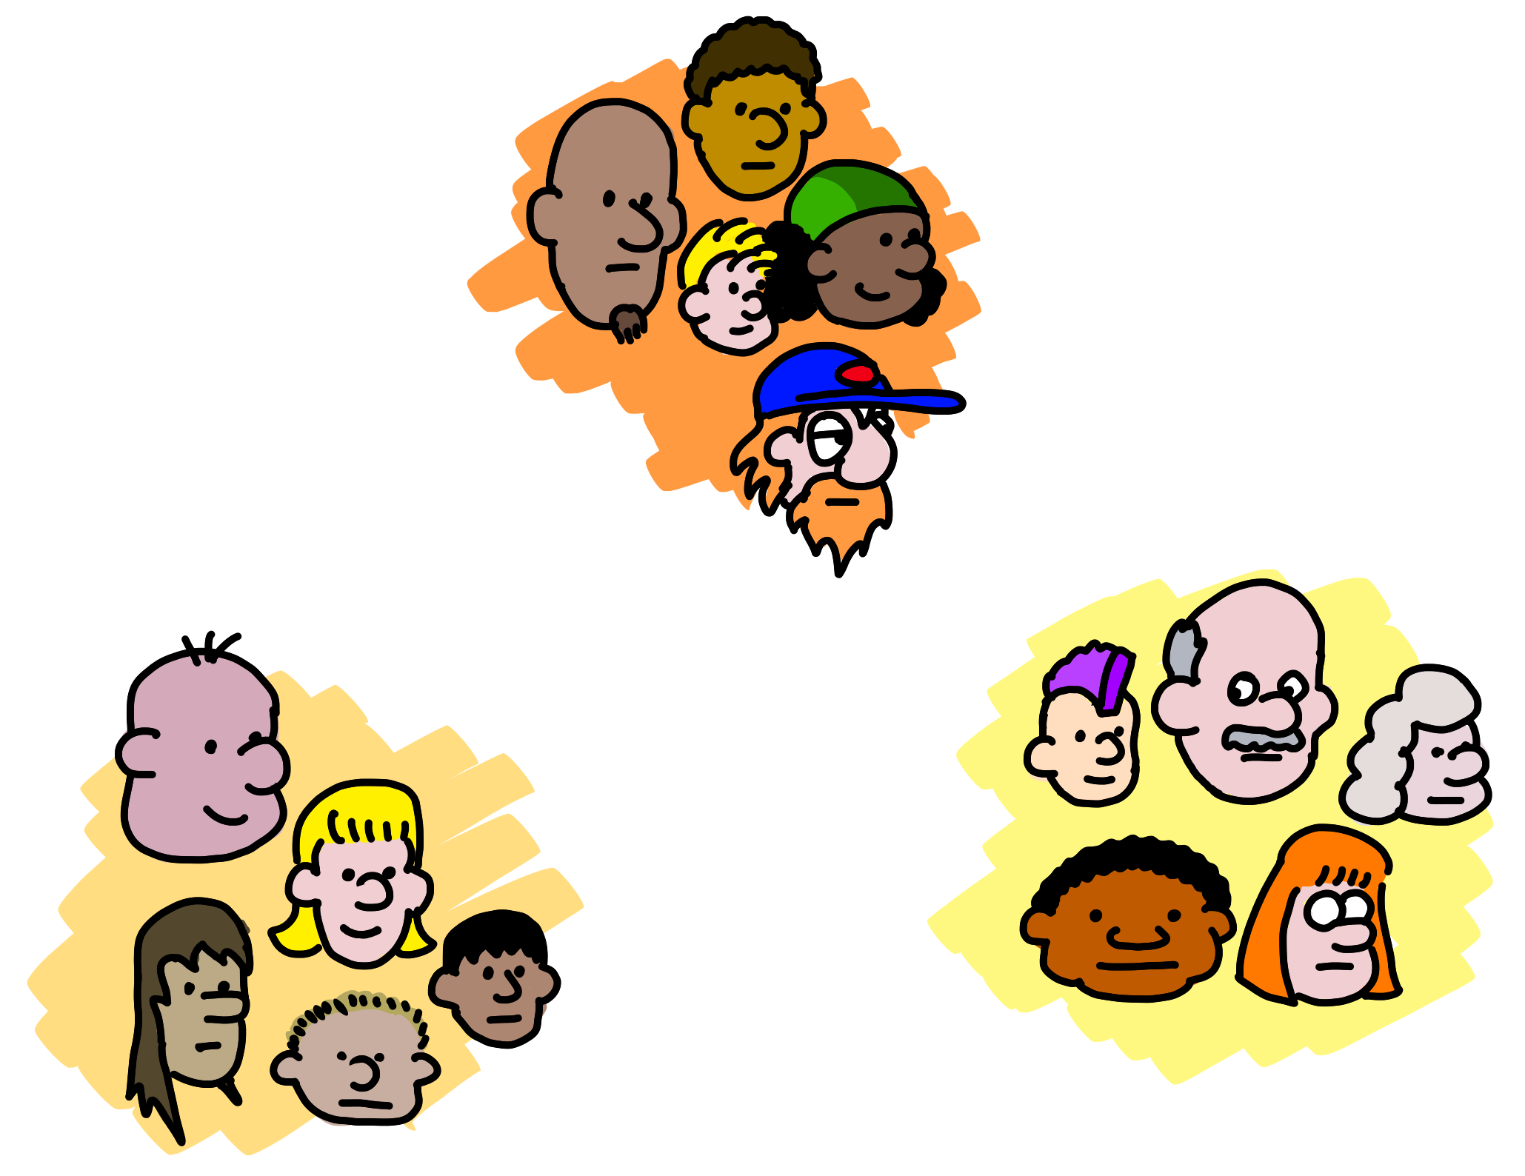

Predict how much/many
(Regression)
What next?
(Reinforcement Learning)
Which category?
(Classification)
Is it weird?
(Anomaly)
Data structure
(Clustering,
Recommender)
5 questions courtesy Brandon Rohrer
Notes:
The five questions you can answer with traditional ML
Regression: Predict a real value for new data given trends in tagged example. How much/how many? e.g. Sea level rise: we are currently using data on sea level changes over the past century and the accelerating upward trend to estimate the amount of sea level rise in the coming century.
Anomaly: Identify when something unexpected happens. – Is this weird? E.g. Pacemaker hacking: research is being done to detect malware in a pacemaker in order to prevent data hijacking or malware-related malfunctioning by using an anomaly detector to pick up changes in data transmission timing to a cardiac log or even power consumption and electromagnetic radiation changes.
Reinforcement Learning: Take some appropriate action or next step E.g. Roomba or Roomba-competitor: a Roomba decides whether to return to the base or vacuum the living room again – there’s some sort of reward/penalty involved here.
Classification: Assign a category to each item or data point E.g. Exploring the night sky for planets: light curves (stellar brightness over time) of a unexamined stars with Kepler data are being classified as either having transiting planets or not using a pre-trained model on stars with and without transiting planets.
Clustering/Recommenders: Get to the structure or layout of data. Are there clearly separable groups? E.g. Hepatocellular carcinoma metastasis: researchers are looking at the differential profiles of proteins being expressed to find those that are upregulated during the cell invasion process in order to find new cancer treatment targets.
Also questions you can’t ask. Que

Slide 7
You don’t have to know math to work here… but it helps!

Slide 8
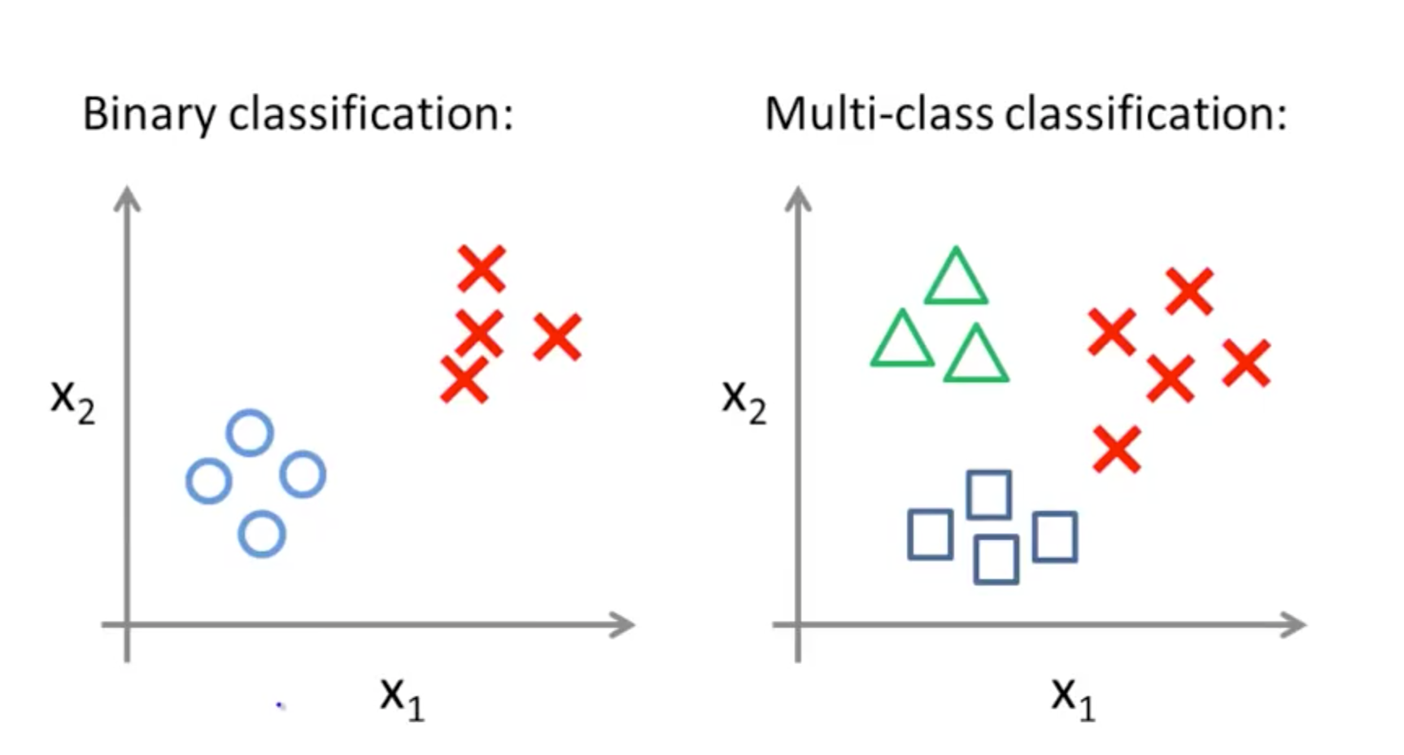

Pick a common ML tool and sample data
Quickstart guide
See some results – how well did it go
Graph data
Get curious – ask a question
Disease or not disease?
Notes:
Path Micheleen took:
Common already developed tool: e.g. Python community’s scikit-learn (http://scikit-learn.org/stable/) or data science community’s mxnet (http://mxnet.io/)
Sample data are found in the packages themselves to learn on
Code snippets and quickstart guides in documentation on package
Also, ways to viz data in docs
Get creative in your questions – maybe do some feature engineering if that’s your cup o’ tea
Play, play, play and if you like validations look into metrics
Repeat with some actual real-world data (warning, you’ll have to clean and aggregate it yourself, but just model it after the sample data)
Good example: Using Mxnet to train a neural network in R in 5 minutes (there’s also the Python version and other languages): http://mxnet.io/tutorials/r/fiveMinutesNeuralNetwork.html
You know you’re “done“ learning a package (Python’s scikit-learn for example from OSS community) when you are able to stay on top of new algorithms/features//techniques. And explain it to someone else.
The prerequisite for ML
The REAL prerequisite for ML is data analysis, not linear algebra, calculus, or other complex math
Data analysis == get, clean, aggregate, explore, visualize (also from https://www.r-bloggers.com/the-real-prerequisite-for-machine-learning-isnt-math-its-data-analysis/)
Why data analysis: machine learning models need carefully examined and cleaned data to work well
What does a data scientist do all day anyway?
Get data from a data source to explore a topic you’ve always wanted to learn about or to improve your business
Clean data to remove noise or missing values or just identify problems
Transform data to create, delete or modify features (aka the columns)
Explore data with some basic stats and summarize it
Visualize data in static or interactive plots to understand trends and patterns
Read about new, interesting data science packages!
<5% math – and that is generous!
Meta point: like an ML model, you are learning by doing. The more you play with this stuff, the more you push into corners, the more you will build your own mental model of how it all fits together.
Then Bill says:
Analogy: learning a new web framework, like React or Angular. First one is a steep learning curve. Second one less so because they will share a lot of concepts, even if they are quite different. In fact the differences can help you understand the domain more deeply.
Similarly with databases. Maybe it took you a year to become really good at SQL Server, because it was your first database. Learning Mongo won’t take you as long, because even though they are pretty different, they still share a lot of ideas, and their differences help you understand some things you probably took for granted.

Slide 9



Easy
Why Microsoft Cognitive Services?
Flexible
Tested

Slide 10
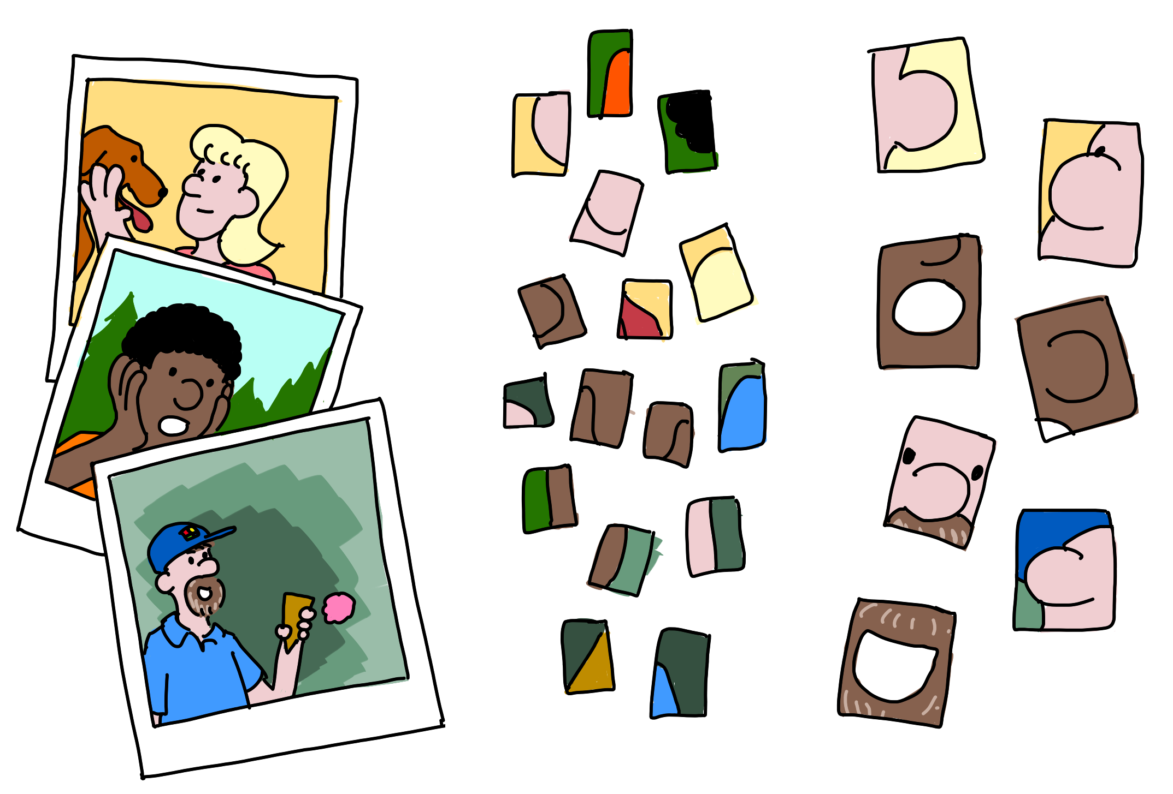
Notes:
Example
Five layers
Input layer (pictures including faces – 3 polaroids)
Edges
Nose/Ears/Eyes/Mouths
Whole Faces
“This is probably Bill”
Our sci-fi future, powered by DNN:
Composing models
Extracting style
Your choice
Main point: DNNs don’t just answer questions, allow us to create and transform

Slide 11








Why Microsoft Cognitive Services?
Easy
Flexible
Tested
Roll your own with REST APIs
Integrate into the language and platform of your choice
Built by experts in their field from Microsoft Research, Bing, and Azure Machine Learning
Simple to add: just a few lines of code required
Breadth of offerings helps you find the right API for your app
Quality documentation, sample code, and community support
GET A KEY
BUILD

Slide 12
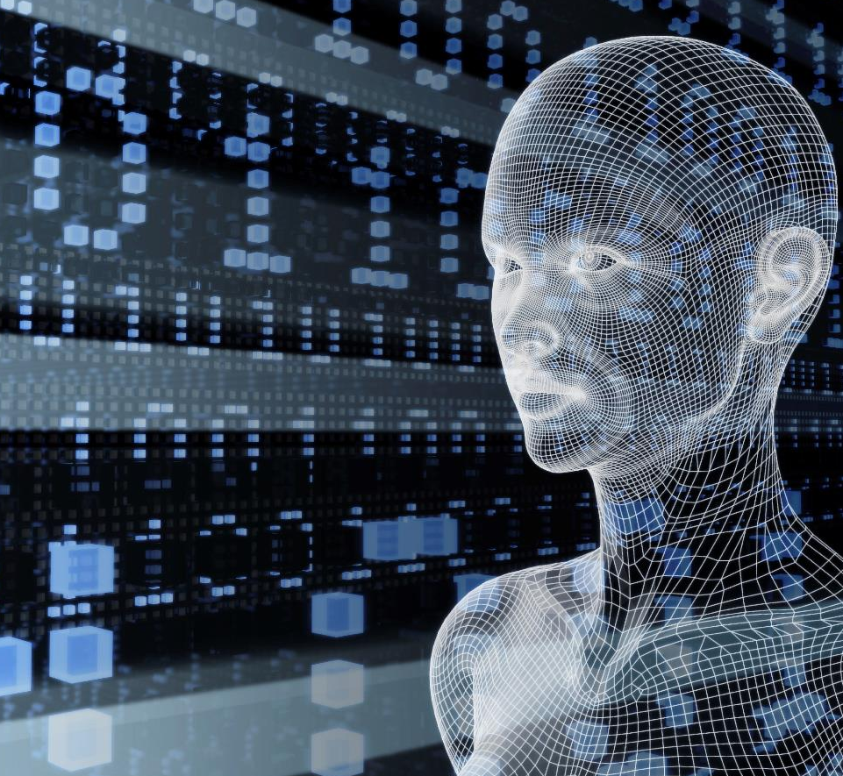
Vision
From faces to feelings, allow your apps to understand images and video
Microsoft Cognitive Services
Give your apps a human side
Speech
Hear and speak to your users by filtering noise, identifying speakers, and understanding intent
Language
Process text and learn how to recognize what users want
Knowledge
Tap into rich knowledge amassed from the web, academia, or your own data
Search
Access billions of web pages, images, videos, and news with the power of Bing APIs

Slide 13
Cognitive Services API Collection
Vision
Computer Vision | Emotion | Face | Video
Microsoft Cognitive Services
Give your apps a human side
Speech
Bing Speech | Custom Speech Service (formerly CRIS) | Speaker Recognition
Language
Bing Spell Check | Language Understanding | Linguistic Analysis | Text Analytics | Translator | Web Language Model
Knowledge
Academic Knowledge | Entity Linking | Knowledge Exploration | QnA Maker | Recommendations
Search
Bing Autosuggest | Bing Image Search | Bing Knowledge Graph | Bing News Search | Bing Video Search | Bing Web Search

Slide 14
Cognitive Services Demos

Slide 15
Challenges in creating simple FAQ bots
The knowledge base often already exists
I've got better things to do with my time than recreate this
Requires developers
Developers typically aren't SMEs on the knowledge domain
Need to empower knowledge workers
They're, of course, not developers

Slide 16
Enter QnA Maker
Cognitive Service
Creates a queryable endpoint
Simple JSON request & response
Can be used anywhere
Features
Automatically create knowledge base from FAQ page or document
Editable by users

Slide 17
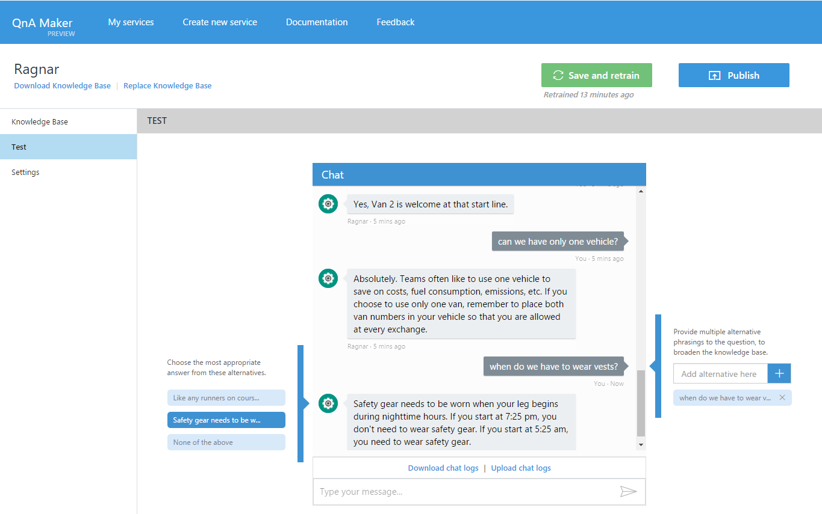

Slide 18
QnA Maker

Slide 19
What did you think of the service provided today?
Everything was terrible! I hated it!!
Thank you so much for your feedback. Have a nice day!

Slide 20
Text Analytics

Slide 21
What is the user saying?
Topics?
Themes?
Language?
Mood?

Slide 22
Text Analytics
Language
Sentiment
Key phrases

Slide 23
The run across Golden Gate was gorgeous!
Key phrases:
{ "documents":
[
{
"keyPhrases":
[ "run", "Golden Gate" ],
"id": "0"
}
],
"errors": []
}
Sentiment:
{ "documents":
[
{
"score": 0.9304294,
"id": "0"
}
],
"errors": []
}

Slide 24
Text Analytics

Slide 25
Your turn
Update your bot to:
Ask the user for feedback
Reply with an appropriate message based on the feedback

